Slide 1

a Large-scale Knowledge-base to Perform Visuo-semantic Queries over Wikimedia Commons Images
Sebastián Ferrada Aliaga
July 7th, 2017

Slide 2
1.
The Problem

Slide 3

lemon desserts

Slide 4
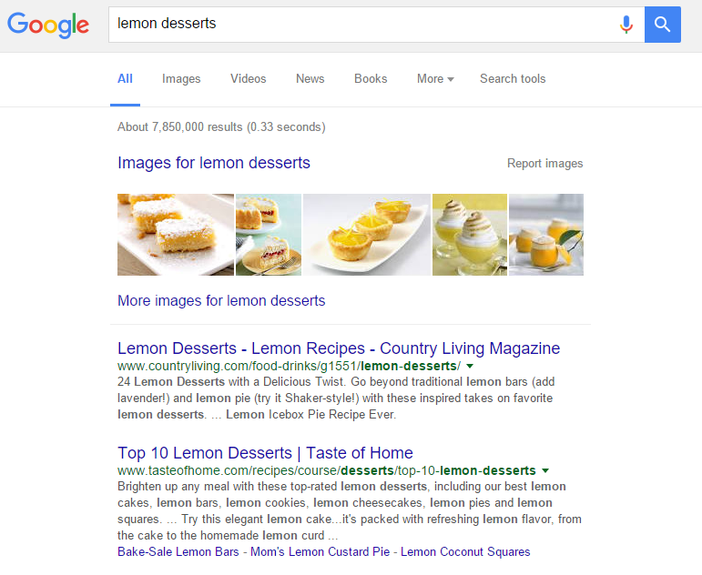

Slide 5
desserts without lemon

Slide 6
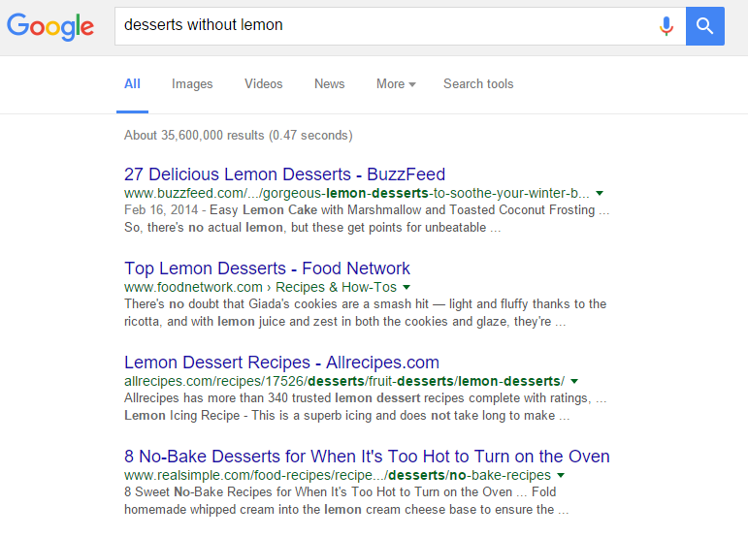

Slide 7





Is it posible for machines to understand sophisticated queries?
SELECT ?food WHERE{
?food a food:Dessert;
food:containsIngredient ?ingredient .
?ingredient rdfs:label ?name .
FILTER(LANG(?name) = "en" && CONTAINS(?name,"lemon"))
}

Slide 8
How can these technologies be used to manage content-based similarity of multimedia resources?

Slide 9
european cathedrals

Slide 10
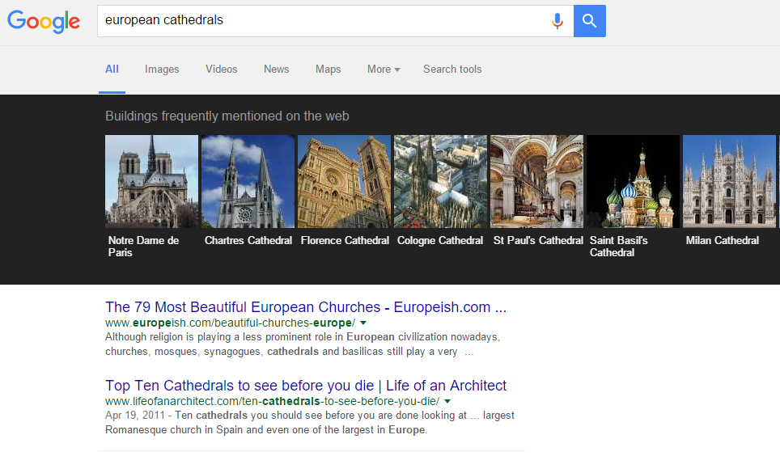
We can easily find related images

Slide 11
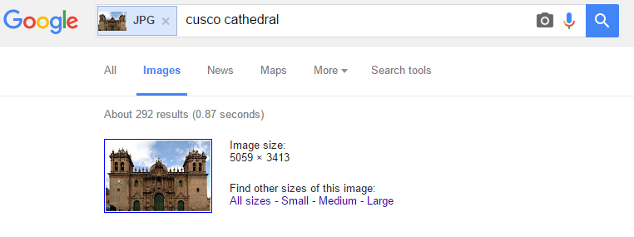
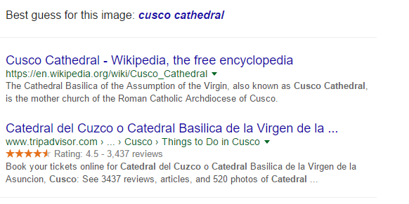
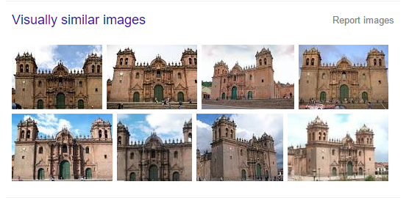
… and visually similar images

Slide 12
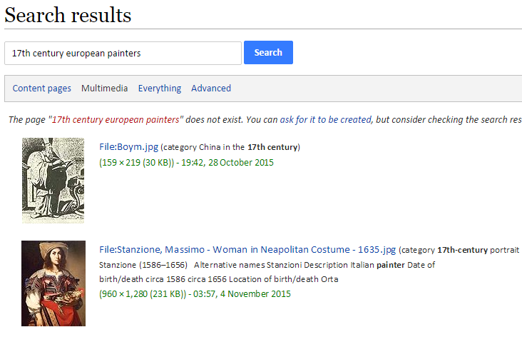
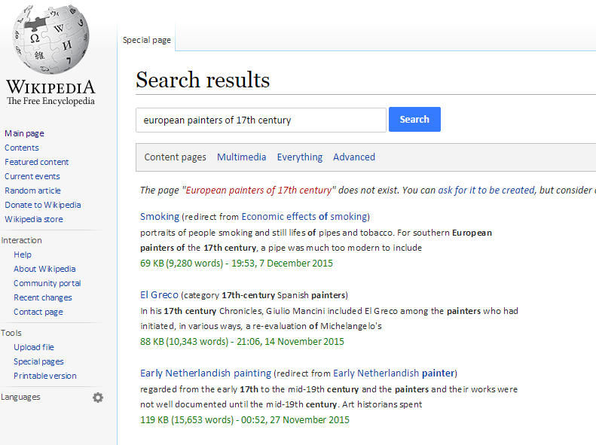
However, there are tools that can’t manage

Slide 13
2.
The Objective

Slide 14
To provide a means to combine semantic queries with visual-similarity queries

Slide 15
3.
The Methodology

Slide 16
Methodology
Image Processing
Obtain a local copy of images
Compute visual descriptors
Similarity Search
Find a suitable tool
Compute static similarity relations
Linked Data
Define an ontology
Parse raw data
Publish a SPARQL endpoint

Slide 17
4.
The Image Processing

Slide 18
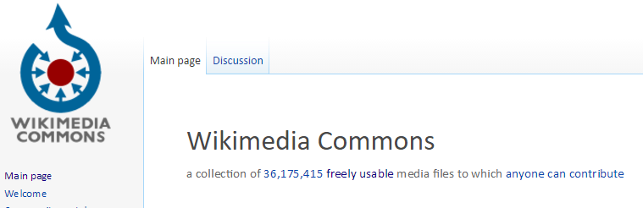
Download Wikimedia Commons Images
14.7 million images (JPG and PNG)
22 TB

Slide 19
Download Wikimedia Commons Images
16 rsync connections
500 GB per day

Slide 20



Reference Implementations of Visual Descriptors
Gray Histogram Descriptor (GHD)
Histogram of Oriented Gradients (HOG)
Color Layout Descriptor (CLD)
DeCAF7

Slide 21
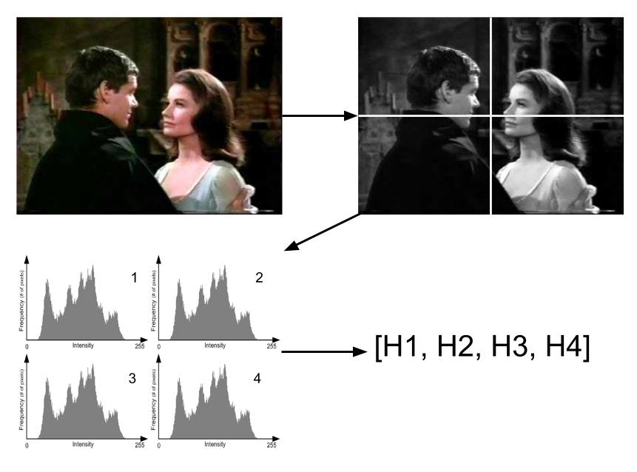
Gray Histogram Descriptor (GHD)

Slide 22
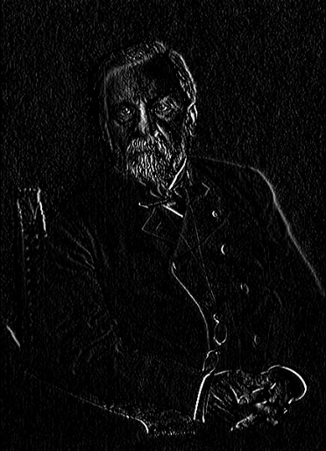
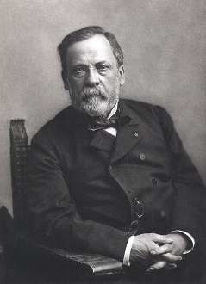
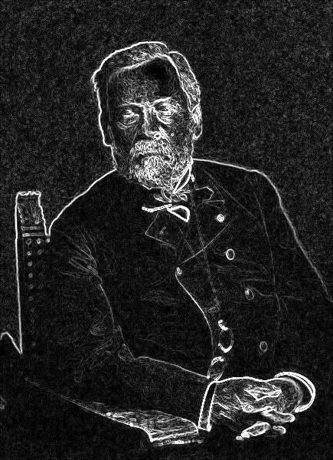
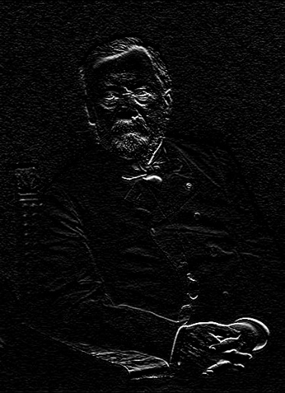

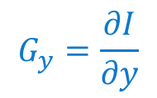
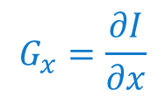
Histogram of Oriented Gradients (HOG)
$$G_{x}=\frac{∂I}{∂x}$$
$$\left\|\overset{⃑}{∇}I\right\|$$
$$G_{y}=\frac{∂I}{∂y}$$

Slide 23
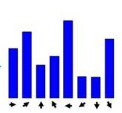
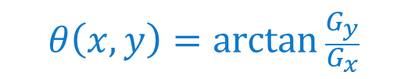
Histogram of Oriented Gradients (HOG)
$$θ\left(x,y\right)=\arctan{\frac{G_{y}}{G_{x}}}$$

Slide 24
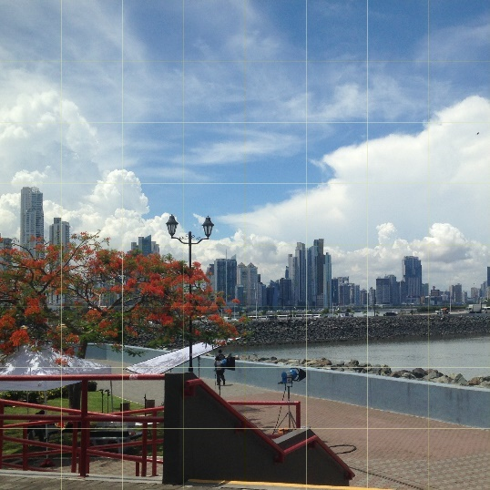

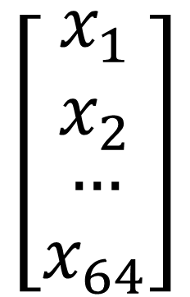
Color Layout Descriptor (CLD)
$$\left[\begin{matrix}\begin{aligned}x_{1} \\ x_{2}\end{aligned} \\ … \\ x_{64}\end{matrix}\right]$$
YUV
DCT

Slide 25

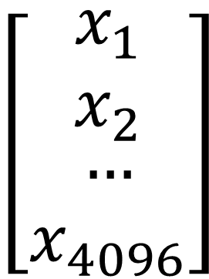
DeCAF7
$$\left[\begin{matrix}\begin{aligned}x_{1} \\ x_{2}\end{aligned} \\ … \\ x_{4096}\end{matrix}\right]$$

Slide 26
Descriptor Extraction
Descriptor | Average execution time [ms]
 | Single thread | Multithread
GHD | 119.4 | 10.4
HOG | 477.7 | 25.7
CLD | 436.7 | 30.4
DeCAF7 | 3634.8 | 3809.7
Notes:
We take a benchmark to evaluate the viability of the project

Slide 27
43 Hours
107 Hours
127 Hours
GHD
HOG
CLD
Non-viable
DeCAF7

Slide 28
5.
The Similarity Search

Slide 29
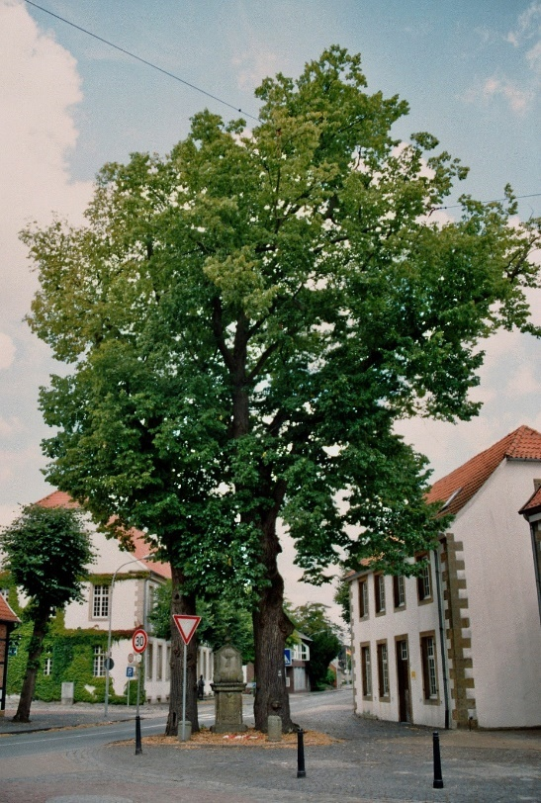
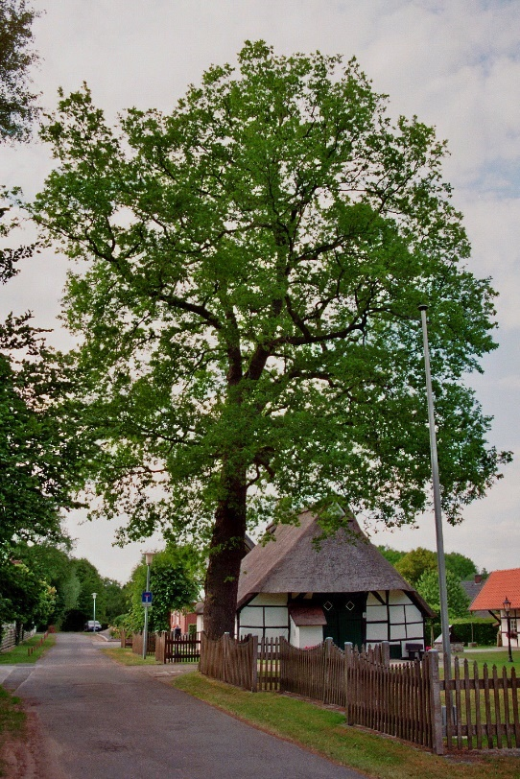
Goal
similar

Slide 30
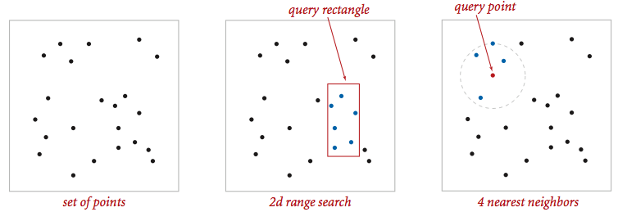
How?

Slide 31
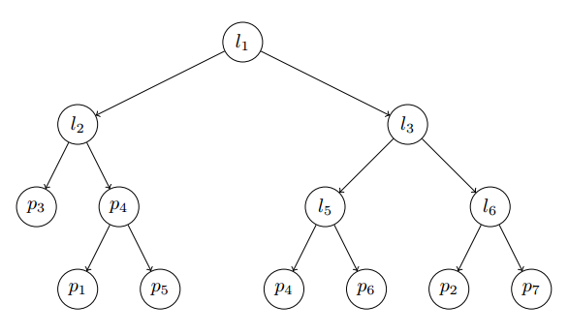
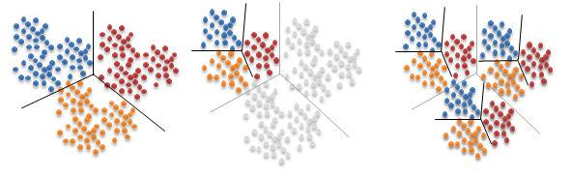
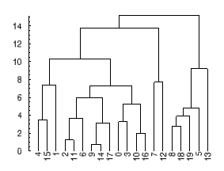
Find a Suitable Tool
Fast Libary for Approximate Nearest Neighbors (FLANN)

Slide 32
FLANN
 | Ground Truth | FLANN
Execution time [mins] | 279 | 17
Precision | 100% | 79%

Slide 33
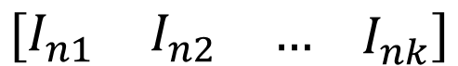
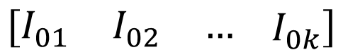
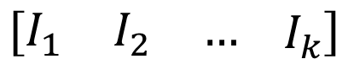
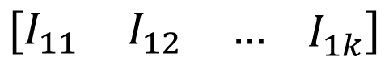
Implementation
Matrix 1
$$\left[\begin{matrix}I_{01} & I_{02} & …\end{matrix} I_{0k}\right]$$
Matrix 2
$$\left[\begin{matrix}I_{11} & I_{12} & …\end{matrix} I_{1k}\right]$$
Query Matrix
$$\left[\begin{matrix}I_{1} & I_{2} & …\end{matrix} I_{k}\right]$$
…
…
Matrix n
$$\left[\begin{matrix}I_{n1} & I_{n2} & …\end{matrix} I_{nk}\right]$$

Slide 34
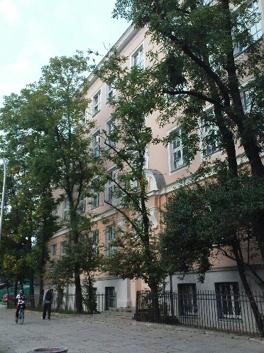
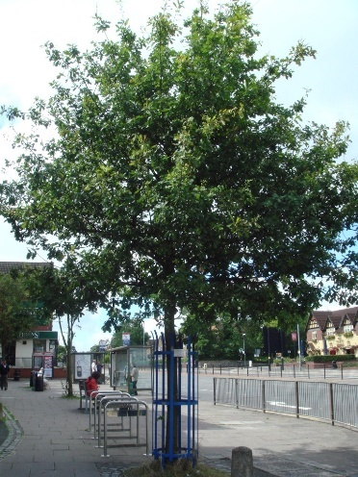
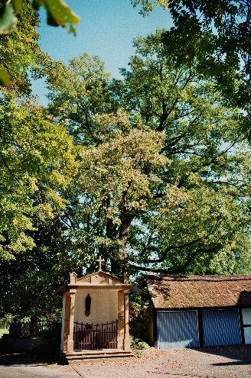
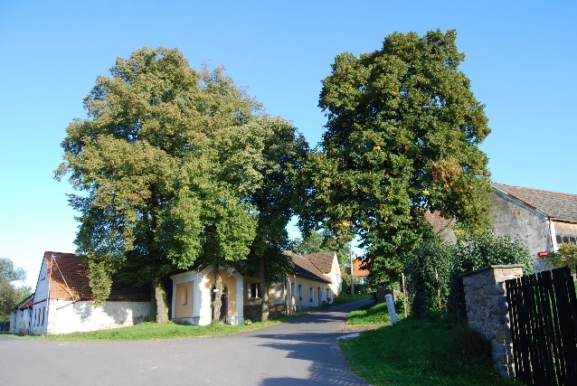
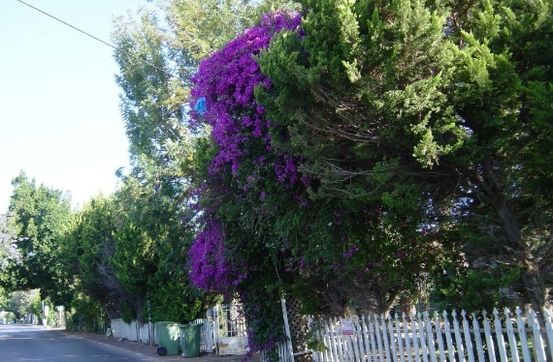
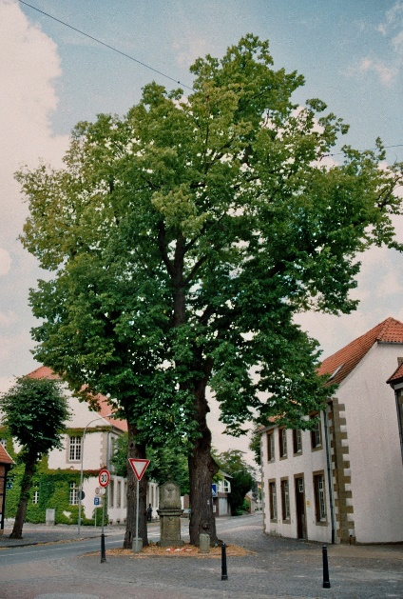
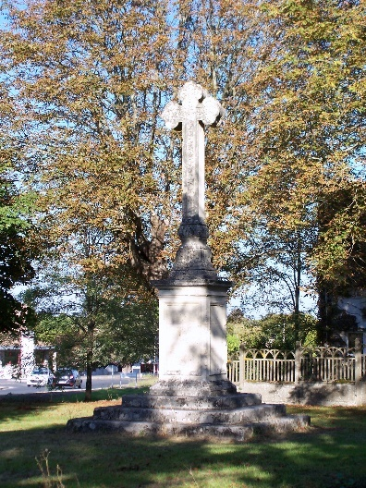

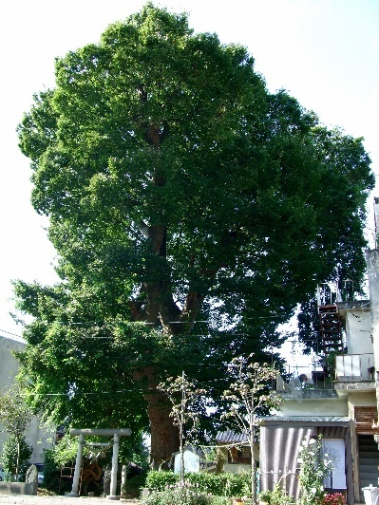
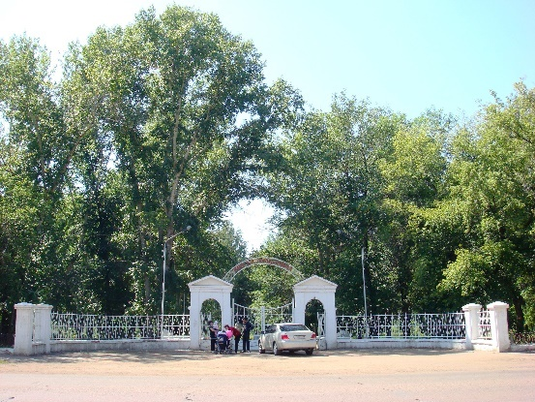
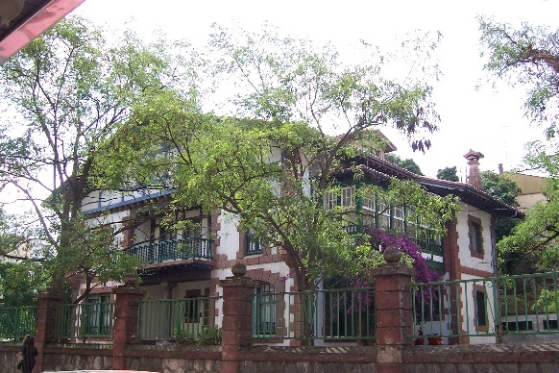
Results (HOG)

Slide 35
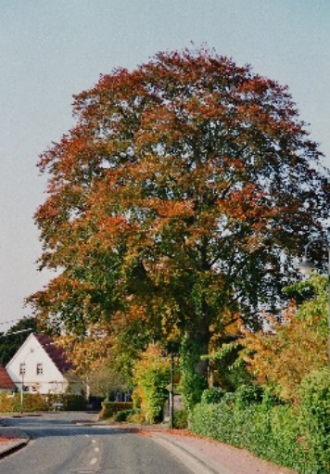
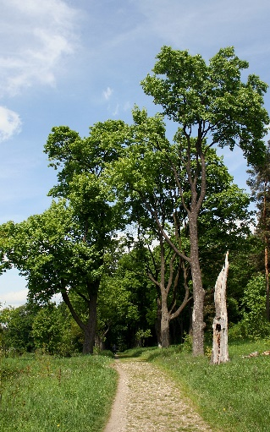
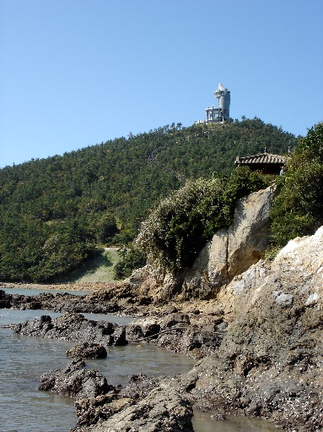
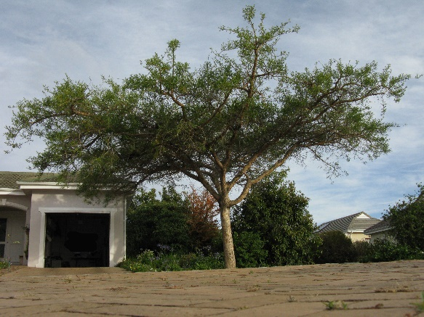
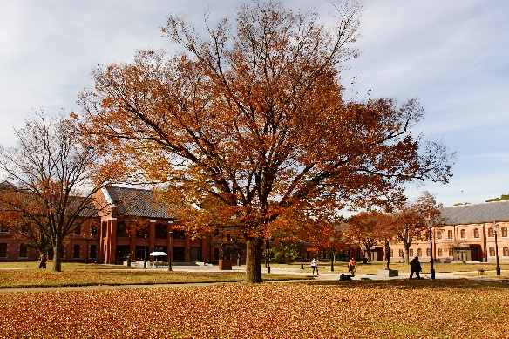
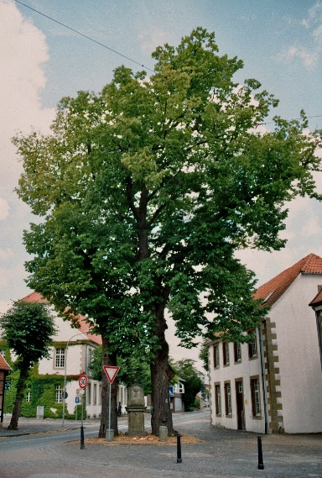
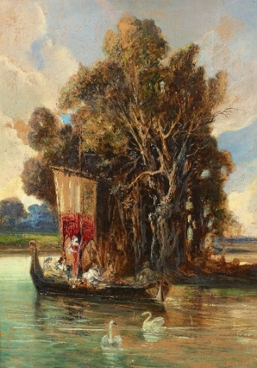
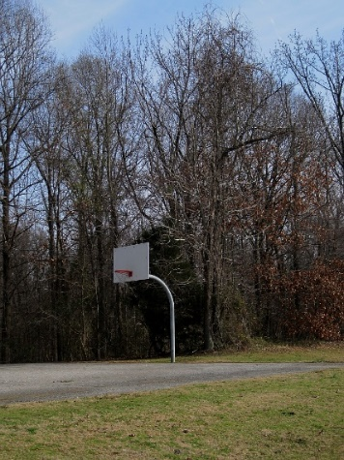
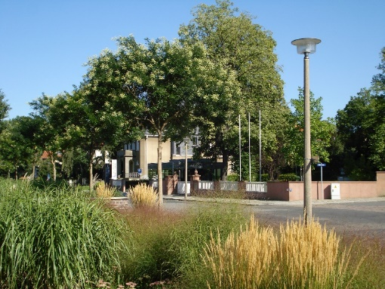


Results (GHD)

Slide 36






Results (CLD)

Slide 37











Results (CLD)

Slide 38
Summary
13 Hours
Computation time of k-NN per descriptor
3 Graphs
Containing similarity relations: 14.7M nodes, 150M edges each
442,959,000 Similarity Links
In total

Slide 39

Similarity Graph
similar

Slide 40
6.
The Knowledge-Base

Slide 41

IMGpedia Ontology

Slide 42

Links to DBpedia

Slide 43

Links to DBpedia
imo:appearsIn
dbr:Quentin_Tarantino

Slide 44
Data Structure
"1951-09-29"^^xsd:date
300
400
“Michelle Bachelet”
dbo:birthDate
imo:height
imo:width
dbo:name
imo:appearsIn
dbr:Michelle_Bachelet
im:bachelet.jpg
imo:fileURL
foaf:depiction
rdf:type
dbo:office
wcf:bachelet.jpg
“President of Chile”
imo:Image
owl:sameAs
dbc:bachelet.jpg

Slide 45


Parse Raw Data to RDF

Slide 46
14,765,300 Images
Visual Entities
44,295,900 Descriptors
3 descriptors per image
442,959,000 Similarity Links
Image Relations
12,683,424 Context Links
To DBpedia

Slide 47

SPARQL Endpoint
imgpedia.dcc.uchile.cl/sparql
Notes:
Virtuoso server, provides endpoint anr URL rewrite tools for dereferencing IRIS

Slide 48
7.
The Results

Slide 49
4,111,399,891
RDF Triples in IMGpedia

Slide 50





Use-cases
SELECT DISTINCT ?Target
WHERE {
im:Hopsten_Marktplatz_3.jpg imo:similar ?Target .
}
Notes:
Obtaining similar images

Slide 51










Use-cases
SELECT DISTINCT ?Target ?Distance
WHERE {
?rel imo:sourceImage im:Hopsten_Marktplatz_3.jpg ;
imo:usesDescriptorType imo:GHD ;
imo:targetImage ?Target ;
imo:distance ?Distance .
}
ORDER BY ?Distance
11
11,2
11,6
11,9
11,9
11,9
12
12,1
12,1
12,2
Notes:
Obtaining a specific descriptor, sorted by distance

Slide 52
Use-cases
SELECT DISTINCT ?label
WHERE {
im:PaodeAcucar.JPG imo:similar ?img .
?img imo:appearsIn ?res
SERVICE <https://dbpedia.org/sparql> {
?resource rdfs:label ?label .
FILTER(LANG(?label) = "en")
}
}
“Laxminarayan Temple”@en
“ArcelorMittal Orbit”@en
“Asagiri-class destroyer”@en
“Gifu Castle”@en
“Gran Sabana”@en
Notes:
Obtain Labels from DBpedia

Slide 53
Use-cases
SELECT DISTINCT ?url ?label
WHERE {
SERVICE <https://dbpedia.org/sparql> {
?res a yago:Wikicat16th-centuryPaintings ;
dcterms:subject dbc:Paintings_of_the_Louvre ;
rdfs:label ?label
FILTER(LANG(?label)="en") }
?img imo:appearsIn ?res ;
imo:fileURL ?url .
}

Slide 54

Use-cases

Slide 55
Use-cases
SELECT DISTINCT ?source ?target
WHERE {
SERVICE <https://dbpedia.org/sparql> {
?sres dcterms:subject dbc:Roman_Catholic_cathedrals_in_Europe }
?source imo:appearsIn ?sres ;
imo:similar ?target .
?target imo:appearsIn ?tres ;
imo:fileURL ?urlt .
SERVICE <https://dbpedia.org/sparql> {
?tres dcterms:subject ?subject .
FILTER(CONTAINS(STR(?sub), “Museum”))}
}

Slide 56

Use-cases

Slide 57
8.
The Conclusions

Slide 58
Conclusions
✓
Reference implementations were released
✓
IMGpedia dataset was generated and released
✓
Scalable tool for similarity search was found and used
✓
IMGpedia was released as part of the LOD
✓
SPARQL endpoint is publicly available

Slide 59

Conclusions

Slide 60
5-Star Linked Open Data

Slide 61
Conclusions
IMGpedia enables combining visual similarity queries with semantic queries

Slide 62
Conclusions
imo:appearsIn relation enables to combine information of IMGpedia with DBpedia facts

Slide 63
Conclusions
The proposed methodology can be reused. Code is freely available.

Slide 64
9.
The Future

Slide 65


Incorporate more descriptors
Train our own network?

Slide 66

Analyze and Characterize the Similarity Graph
Notes:
Is it connected? are there communities?

Slide 67
Query-by-example and Indexing

Slide 68

Include links to Wikidata Resources

Slide 69

Develop a Web Application

Slide 70
Thanks!
Any questions?
You can find me at:
sferrada@dcc.uchile.cl

Slide 71
a Large-scale Knowledge-base to Perform Visuo-semantic Queries over Wikimedia Commons Images
Sebastián Ferrada Aliaga
July 7th, 2017

Slide 72

HOG k-NN Distances

Slide 73

GHD k-NN Distances

Slide 74

CLD k-NN Distances

Slide 75
a Large-scale Knowledge-base to Perform Visuo-semantic Queries over Wikimedia Commons Images
Sebastián Ferrada Aliaga
July 7th, 2017

